Slide 1


Multi-scanner Harmonization of Paired Neuroimaging Data via Structure Preserving Embedding Learning
Mahbaneh Eshaghzadeh Torbati¹, Dana L. Tudorascu¹, Davneet S. Minhas¹, Pauline Maillard², Charles S. DeCarli², Seong Jae Hwang¹
1. University of Pittsburgh
2. University of California, Davis

Slide 2
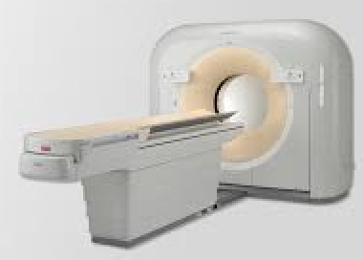
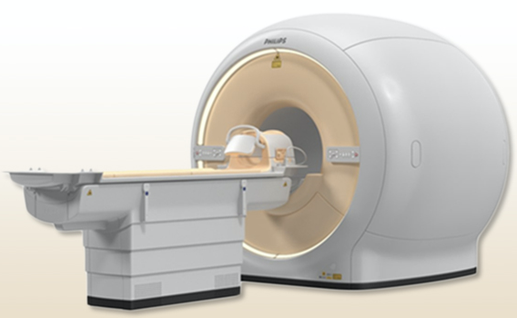
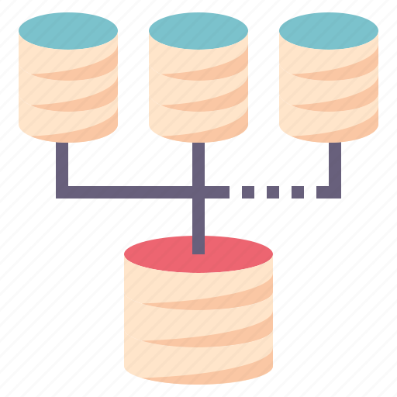
Motivation
Combine neuroimaging
data from different sites.
Each site may have different scanners.
Advantage:
Increase the power of hypothesis tests in studies
Problem:
Scanner effects: Increased bias and variance in data due to added variability by scanners.
Notes:
In the modern neuroimaging studies, combining datasets from multiple sites has become more prevalent. This increases the power of hypothesis tests in the studies. However, sites may vary in their scanners and may result in increased bias and variance for the aggregated data. This imposed variability is called scanner effects.

Slide 3
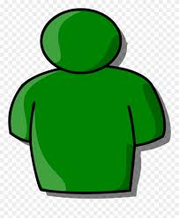
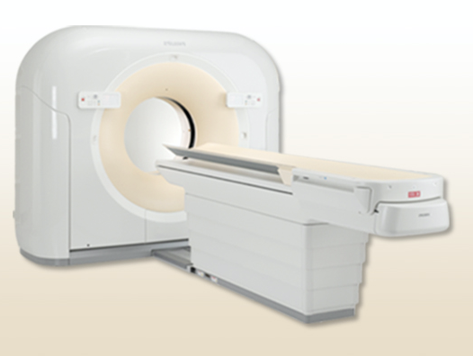
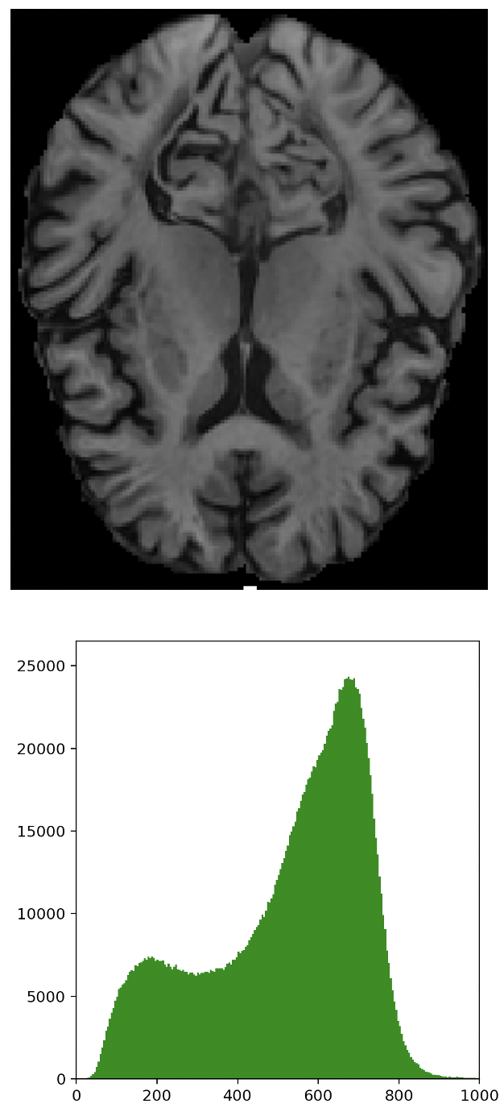
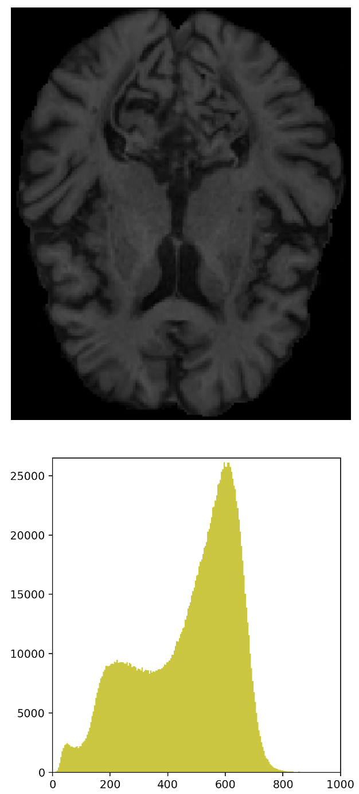
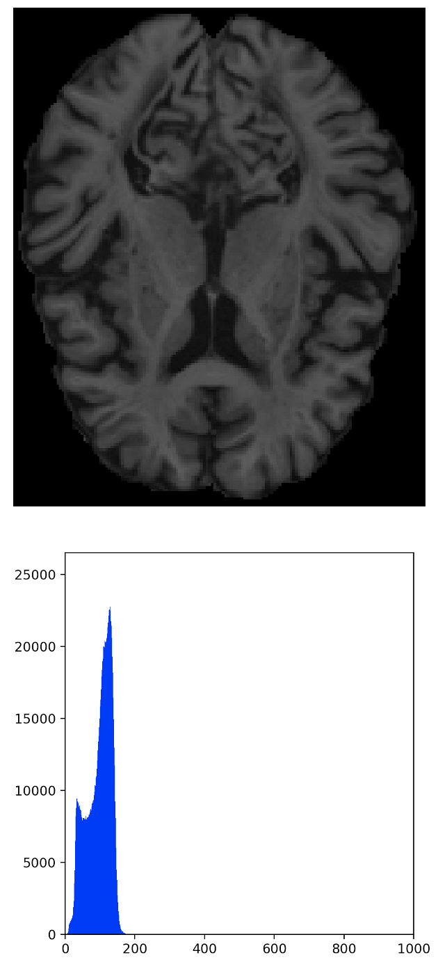
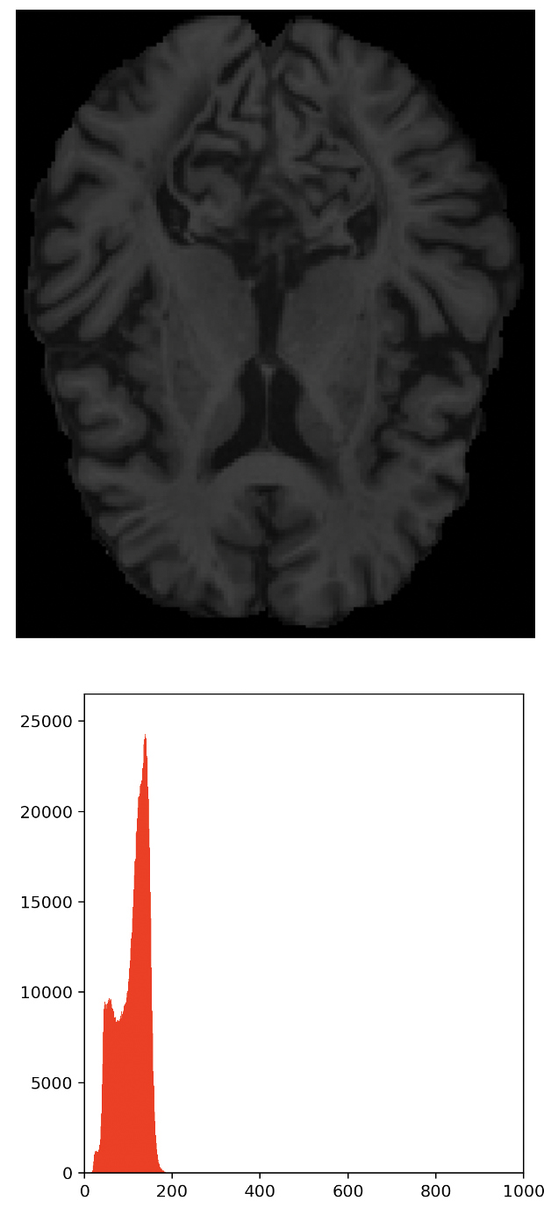
Scanner Effects: Example
Contrast
Intensity
Histograms
Notes:
Here we have an example of the scanner effects. These 4 images are the same axial slices of a subject scanned on 4 different scanners with no time gap. Even though we expect to see similar images, the images are different in at least their contrast and intensity histograms.

Slide 4
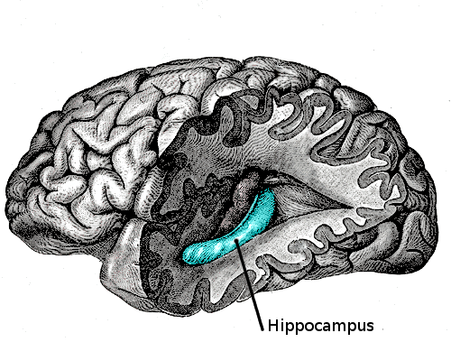
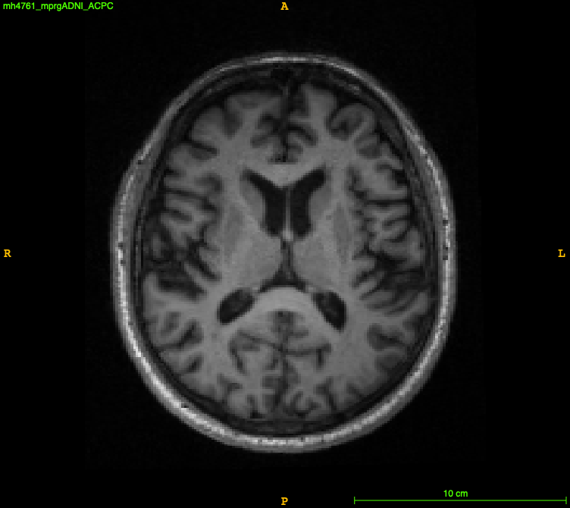
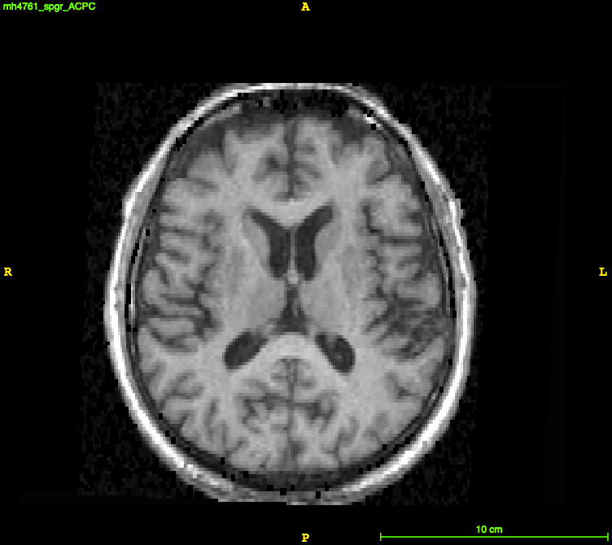
Scanner Effects: the imposed problem
Scanner effects
Hippocampal Volume (cm³)
Neuroimaging Pipeline
Scanner 1
3.9 cm³
Segmentation
Neuroimaging Pipeline
Scanner 2
3.5 cm³
Short delay
Notes:
Consider this scenario in which one subject was scanned on two different scanners with short delay and resulted in dissimilar images due to the scanner effects. Then, a neuroimaging pipeline like segmentation can give us dissimilar image-derived summary measures such as hippocampus which is a biomarker of Alzymer’s disease.

Slide 5
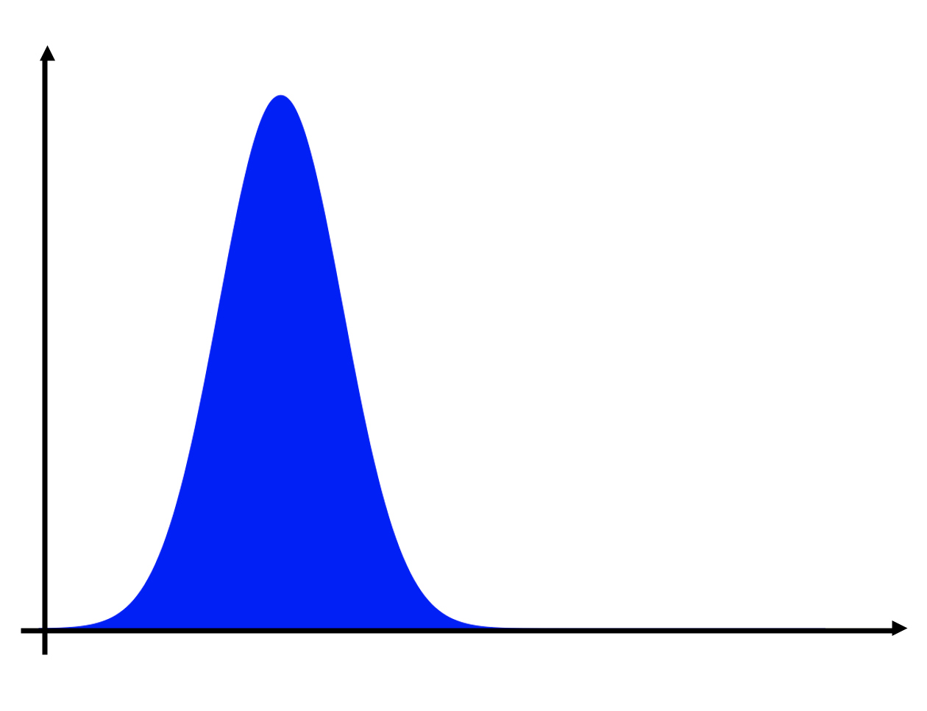
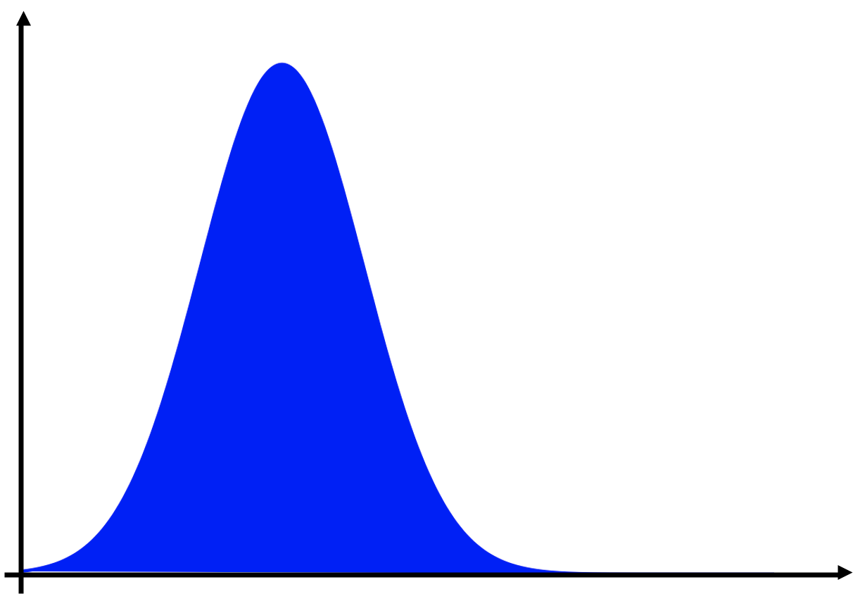
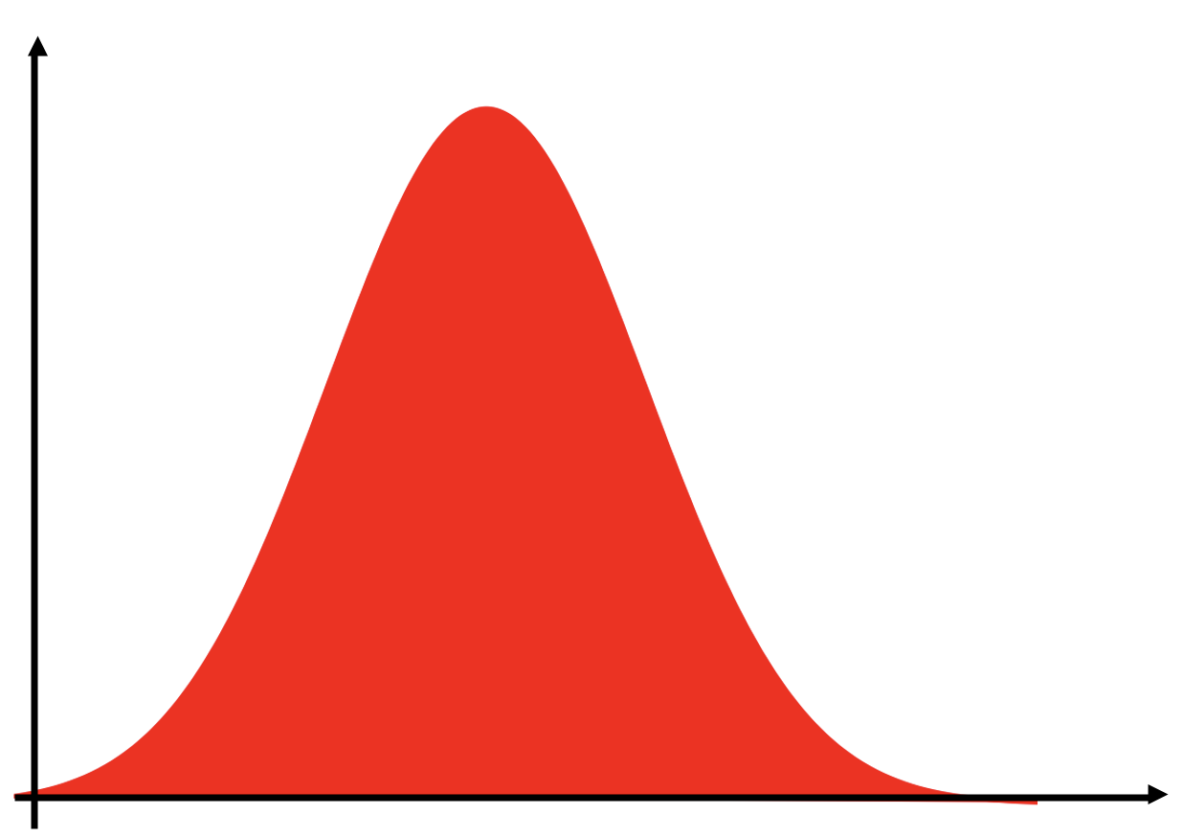
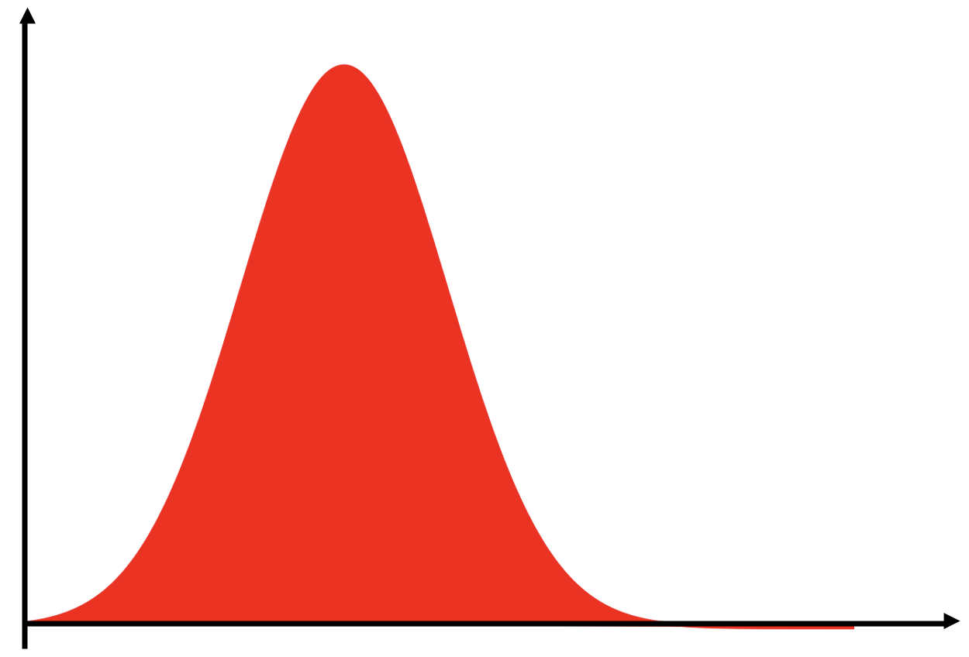
Harmonization
Regional-level Harmonization: Harmonize image-derived summary measures.
ComBat.
Hippocampal Volume (cm³)
Hippocampal Volume (cm³)
3.9 cm³
3.8 cm³
ComBat
3.5 cm³
3.8 cm³
Notes:
The task of removing scanner effects is called harmonization. A group of harmonization methods called regional-level, harmonizes the image-derived summary measures directly. ComBat is an example of such methods. It is a location and scale adjustment methods aims to make the distribution of summary measures of scanners similar to each other and harmonizes the summary measures by making them similar.

Slide 6
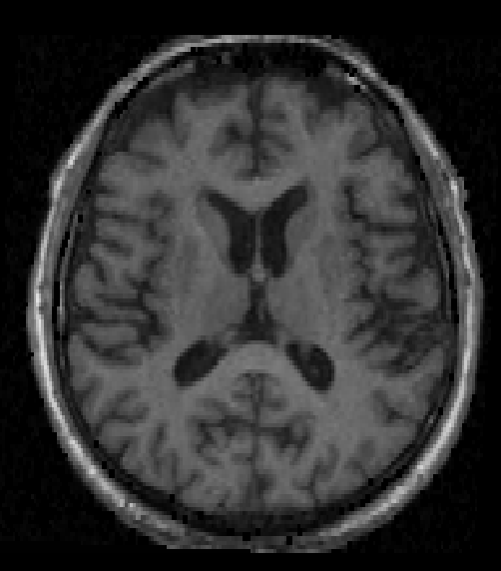
Harmonization
Image-level Harmonization: Harmonize images directly by making them similar.
Harmonize Images
Hippocampal Volume (cm³)
Scanner 1
Neuroimaging Pipeline
3.8 cm³
Harmonize
Neuroimaging Pipeline
3.8 cm³
Scanner 2
Relatively a more challenging approach, but
Directly tackles the source of the problem.
Harmonized images for any downstream tasks.
Limitation of available methods:
Selection of a target scanner.
Limitation to images of two scanners.
Notes:
The other group of harmonization methods targets the images directly to make them similar to each other.
Targeting images for harmonization is a more challenging approach, but this helps to tackle the source of the problem and harmonize images for any downstream tasks.
The available harmonization methods of this type have two main limitations: First, they need to select one of the scanners as target scanner to adapt other images to. Second, they are limited to harmonizing images of just two scanners.

Slide 7
Method: MISPEL
Multi-scanner
Image harmonization with Structural
Preserving
Embedding
Learning
Image-level Harmonization approach.
Harmonizing multiple scanners.
No selection of target scanner.
Notes:
We propose MISPEL which is an image-level harmonization approach. It can be used for harmonizing multiple scanners without the need for selecting a target scanner.
With MISPEL, we try to harmonize images by preserving their structural information.

Slide 8
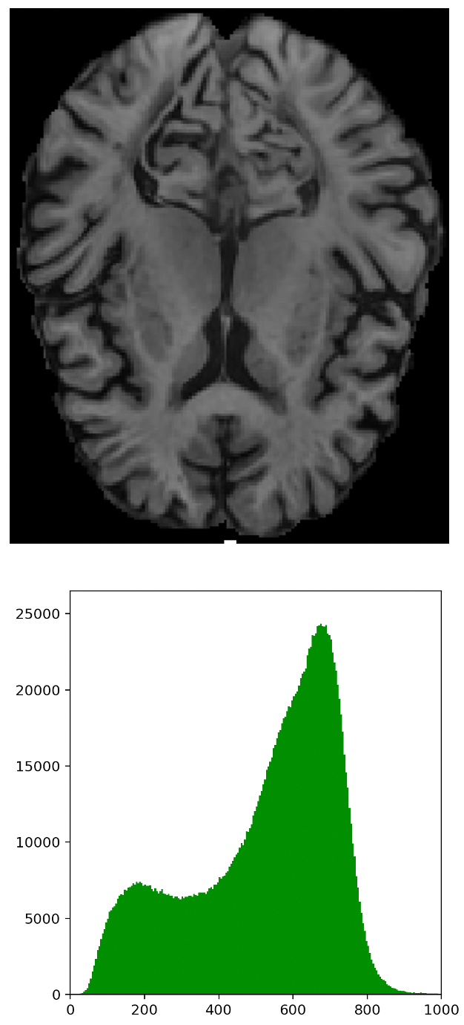

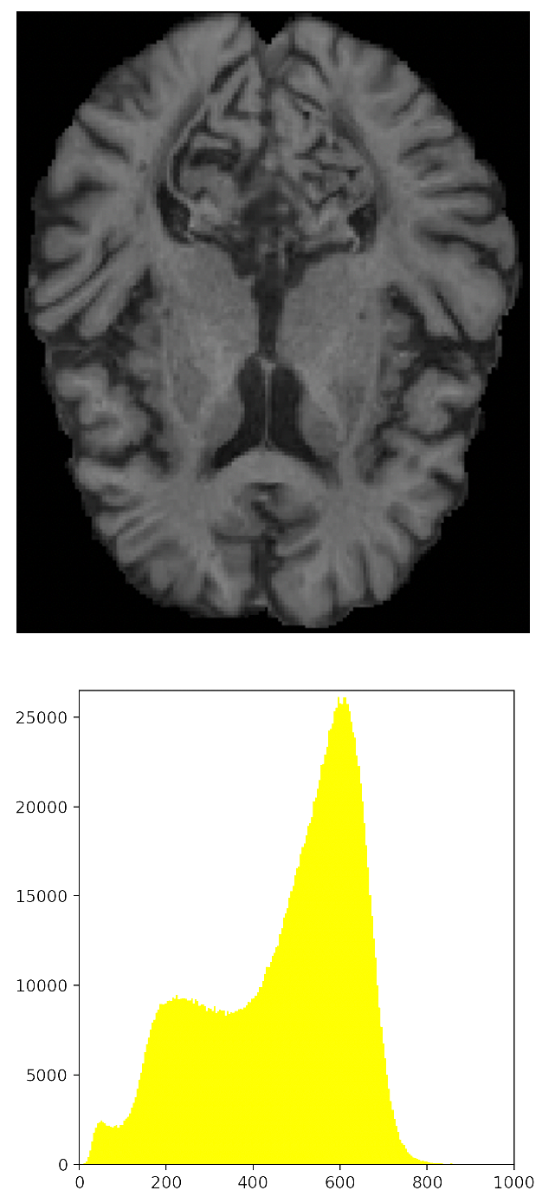


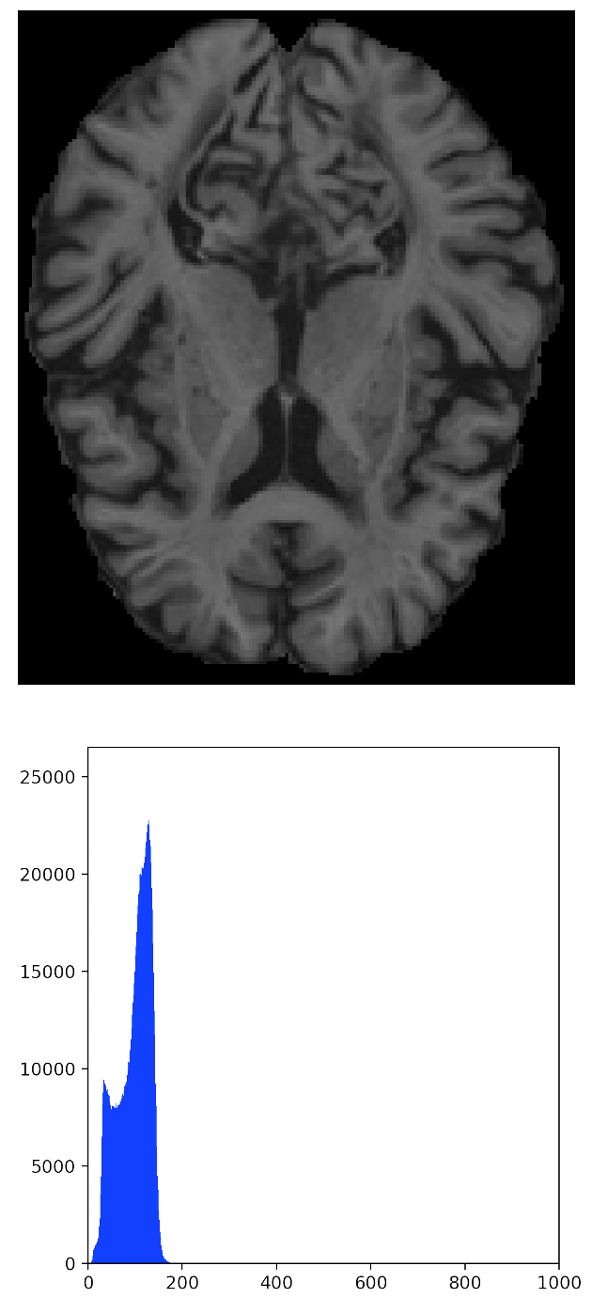

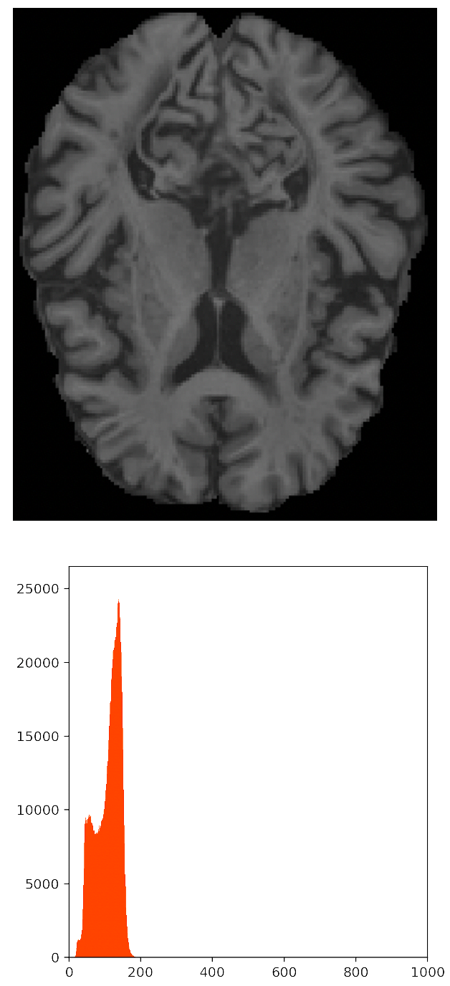
Paired Data
(GE)
(Philips)
Harmonize
18 Subjects
Short delay
(Prisma)
(Trio)
Notes:
To do so, we need a paired dataset.
A paired dataset is collected by scanning traveling subjects on different scanners within short period of time.
Our paired dataset was collected for 18 subjects scanned on 4 scanners.
This paired data, gives us sets of paired slices which are the same slices of an individual's brain conveying the scanner effects. The example of the paired slices can be seen in this slide.
We designed MISPEL to harmonize these slices by making them similar to each other, while preserving their structure.

Slide 9
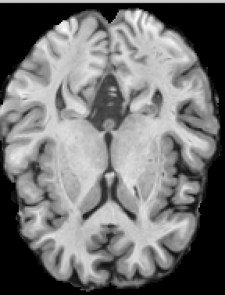
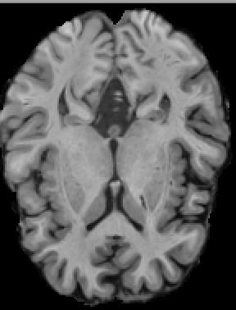
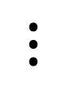
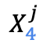
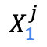
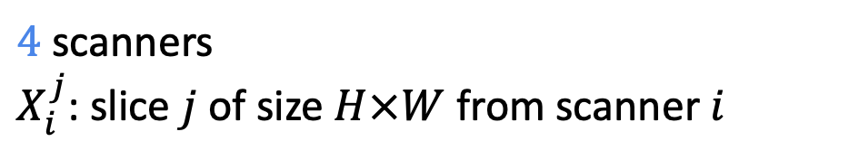
MISPEL: Input
Input Scans
$$X_{1}^{j}$$
$$⋮$$
$$X_{4}^{j}$$
$4$ scanners
$X_{i}^{j}$: slice $j$ of size $H×W$ from scanner $i$
Notes:
We designed MISPEL to give us the embeddings that convey both structural and intensity information of slices.
For this, we give the sets of 4 paired slices to MISPEL as inputs. Xij refers to one of these paired slices, slice j from scanner i.

Slide 10
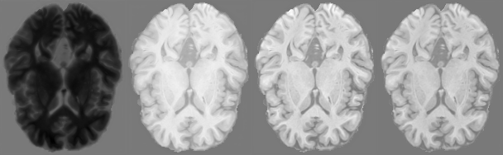
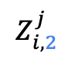
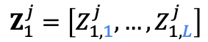
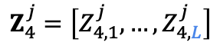
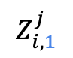
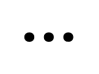
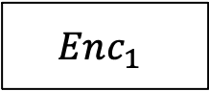
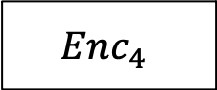
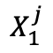
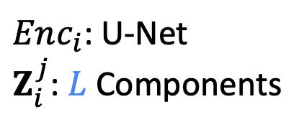
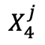
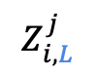
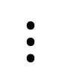
MISPEL: Latent Embedding
Input Scans
Latent Embeddings
$$Enc_{1}$$
$$Z_{1}^{j}=\left[Z_{1,1}^{j},…,Z_{1,L}^{j}\right]$$
$$X_{1}^{j}$$
$$⋮$$
$$⋮$$
$$⋮$$
$$Enc_{4}$$
$$Z_{4}^{j}=\left[Z_{4,1}^{j},…,Z_{4,L}^{j}\right]$$
$$X_{4}^{j}$$
[
$$Z_{i,1}^{j}$$
$$Z_{i,2}^{j}$$
$$Z_{i,L}^{j}$$
]
$Enc_{i}$: U-Net
$Z_{i}^{j}$: $L$ Components
$$⋮$$
Notes:
Then each slice is given to an encoder to extract its latent embeddings. As the encoders, we used U-nets. Zij are the embeddings for slice j and scanner i and consist of L components. In this slide L is 4.

Slide 11
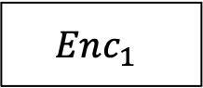
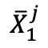
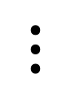
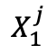
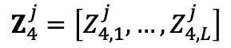
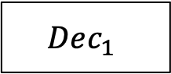
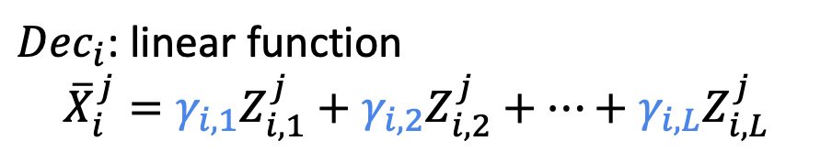
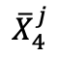
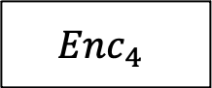
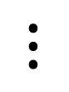



MISPEL: Reconstruction
Input Scans
Latent Embeddings
$$Enc_{1}$$
$$Dec_{1}$$
$$Z_{1}^{j}=\left[Z_{1,1}^{j},…,Z_{1,L}^{j}\right]$$
$$X_{1}^{j}$$
$${\overline{X}}_{1}^{j}$$
$$⋮$$
$$⋮$$
$$⋮$$
$$⋮$$
$$⋮$$
$$Enc_{4}$$
$$Dec_{4}$$
$$Z_{4}^{j}=\left[Z_{4,1}^{j},…,Z_{4,L}^{j}\right]$$
$$X_{4}^{j}$$
$${\overline{X}}_{4}^{j}$$
$Dec_{i}$: linear function
$${\overline{X}}_{i}^{j}=γ_{i,1}Z_{i,1}^{j}+γ_{i,2}Z_{i,2}^{j}+…+γ_{i,L}Z_{i,L}^{j}$$
Notes:
In the final step, the latent embeddings are given to their decoder to reconstruct their corresponding input slice. As decoder, we selected a linear function to combine the L components of the embeddings and generate the reconstructed slice, Xij bar.

Slide 12


















MISPEL: Loss Functions
Input Scans
Latent Embeddings
$ℒ_{recon}$: The dissimilarity
across $X_{i}^{j}s$ and${\overline{ X}}_{i}^{j}$s.
$$Enc_{1}$$
$$Dec_{1}$$
$$Z_{1}^{j}=\left[Z_{1,1}^{j},…,Z_{1,L}^{j}\right]$$
$ℒ_{coup}$: The cross-scanner
dissimilarity of
$$X_{1}^{j}$$
$${\overline{X}}_{1}^{j}$$
$$Z_{i}^{j}s.$$
$$⋮$$
$$⋮$$
$$⋮$$
$$⋮$$
$$⋮$$
$$ℒ_{harm}:The dissimilarity$$
$across {\overline{ X}}_{i}^{j}$s.
$$Enc_{4}$$
$$Dec_{4}$$
$$Z_{4}^{j}=\left[Z_{4,1}^{j},…,Z_{4,L}^{j}\right]$$
$$X_{4}^{j}$$
$${\overline{X}}_{4}^{j}$$
Embedding coupling: $ℒ_{coup}$
Harmonization: $ℒ_{harm}$
Reconstruction: $ℒ_{recon}$
Notes:
For the MSIPEL training step, we designed three loss functions.
Loss of reconstruction estimates the dissimilarity across Xijs and xijbars.
Loss of coupling estimates the cross-scanner dissimilarity of embeddings.
Loss of harmonization estimates the dissimilarity across Xij bars.

Slide 13

Training: Step 1
Input Scans
Latent Embeddings
Reconstructions
$$Enc_{1}$$
$$Dec_{1}$$
$$Z_{1}^{j}=\left[Z_{1,1}^{j},…,Z_{1,L}^{j}\right]$$
$$X_{1}^{j}$$
$${\overline{X}}_{1}^{j}$$
$$⋮$$
$$⋮$$
$$⋮$$
$$⋮$$
$$⋮$$
$$Enc_{4}$$
$$Dec_{4}$$
$$Z_{4}^{j}=\left[Z_{4,1}^{j},…,Z_{4,L}^{j}\right]$$
$$X_{4}^{j}$$
$${\overline{X}}_{4}^{j}$$
Embedding coupling: $ℒ_{coup}$
Learn embeddings that
Reconstruction: $ℒ_{recon}$
Linearly reconstruct the input slices via $ℒ_{recon} {and ℒ}_{coupling }$
By updating both $Enc$ and $Dec$
Notes:
Our model training consists of two steps. Our goal in step 1 is to learn the embeddings. For this, we linearly reconstruct the input slices via loss of reconstruction. We also try to make the embeddings similar across scanners by applying the loss of coupling on them.
For this step, we update both encoders and decoders.

Slide 14










Training: Step 2
Input Scans
Latent Embeddings
Harmonized Scans
$$Enc_{1}$$
$$Dec_{1}$$
$$Z_{1}^{j}=\left[Z_{1,1}^{j},…,Z_{1,L}^{j}\right]$$
$$X_{1}^{j}$$
$${\overline{X}}_{1}^{j}$$
$$⋮$$
$$⋮$$
$$⋮$$
$$⋮$$
$$⋮$$
$$Enc_{4}$$
$$Dec_{4}$$
$$Z_{4}^{j}=\left[Z_{4,1}^{j},…,Z_{4,L}^{j}\right]$$
$$X_{4}^{j}$$
$${\overline{X}}_{4}^{j}$$
Harmonize outputs: ${\overline{X}}_{1}^{j}≈{\overline{X}}_{2}^{j}≈{\overline{X}}_{3}^{j}≈{\overline{X}}_{4}^{j}$
Notes:
In Step 2, we do harmonization by making the reconstructed images in step1, XIJ bars, similar to each other.

Slide 15

Training: Step 2
Input Scans
Latent Embeddings
Harmonized Scans
$$Enc_{1}$$
$$Dec_{1}$$
$$Z_{1}^{j}=\left[Z_{1,1}^{j},…,Z_{1,L}^{j}\right]$$
$$X_{1}^{j}$$
$${\overline{X}}_{1}^{j}$$
$$⋮$$
$$⋮$$
$$⋮$$
$$⋮$$
$$⋮$$
$$Enc_{4}$$
$$Dec_{4}$$
$$Z_{4}^{j}=\left[Z_{4,1}^{j},…,Z_{4,L}^{j}\right]$$
$$X_{4}^{j}$$
$${\overline{X}}_{4}^{j}$$
Harmonization: $ℒ_{harm}$
Reconstruction: $ℒ_{recon}$
Harmonize outputs:
Harmonize via $ℒ_{harm}$
While not too different from input slices via (weakly imposed) $ℒ_{recon}$
By only updating $Dec$
Notes:
For this, in step2, we use Loss of harmonization for making the reconstructed images in step 1, similar to each other. We do so, while we also weakly impose the Loss of reconstruction in order to not make the harmonized images too different from the input slices.
In this step we just update the weights for the decoders.

Slide 16

Results: Visual Quality
Notes:
In our first set of results, we compare the images visually. Here we have a set of paired slices for the images before harmonization, RAW data. As you can see, the images are different in their contrast. Comparing trio to GE, we can see that trio has lower contrast in here.
The second row depicts the same set of paired slices after harmonization by MISPEL. As you can see, slices getting more similar. The difference in contrast between Trio and GE are less noticeable after harmonization.

Slide 17
Results: Image similarity
Structural similarity index measure (SSIM).
Methods | SSIM Between Scanners
Methods | GE-Philips | GE-Prisma | GE-Trio | Philips-Prisma | Philips-Trio | Prisma-Trio
RAW | 0.75 (0.04) | 0.78 (0.04) | 0.78 (0.05) | 0.81 (0.03) | 0.81 (0.03) | 0.87 (0.04)
MISPEL | 0.84 (0.04) | 0.85 (0.04) | 0.86 (0.05) | 0.87 (0.03) | 0.87 (0.03) | 0.91 (0.03)
Table 1. Pairwise comparison of image similarity across scanners. The reported values are the Mean (SD) of SSIMs.
Notes:
We also estimated the similarity of the images by estimating the structural similarity index measure (SSIM) for the pairwise combination of the scanners. We totally have 6 comparisons. As you can see by applying the MISPEL harmonization, the similarities were improved for all the 6 comparisons. The SSIMs for the MISPEL-harmonized images are statistically significantly better than the results for RAW.

Slide 18




Results: Volumetric Similarity
GM
WM
Tissue
Segmentation
Volume
Extraction
GM Volume
WM Volume
Gray Matter
White Matter
Notes:
As another set of experiments, we studied the scanner effects and harmonization on the GM and WM volumes. For this, we first run the FSL segmentation on all images to segment out the Gray matter and white matter tissue types for the images. We then extract the volumes of these segments and studied the boxplots of their distributions.
Ideally, we expect the boxplots for RAW data to be identical across scanners for both GM and WM. But it is not happening. This dissimilarity is actually an evidence of the scanner effects in our data.
However, you can see that after applying the MISPEL harmonization, the boxplots of the scanners getting more similar. This happens for both GM and WM volumes.

Slide 19
Conclusions and Future work
Introduced the concept of harmonization.
Introduced MISPEL, a multi-scanner image harmonization with structural preserving embedding learning.
As our future work, we aim to:
seek further qualitative assessments by expert neuroradiologists to clinically validate our work.
investigate how our harmonization framework may impact potential downstream analyses.
and investigate our method on other MR modalities, such as Flair.
Notes:
In this work, we introduced the concept of harmonization and Mispel, a multi-scanner image harmonization with structural preserving embedding learning.
As our future work, we aim to seek further qualitative assessments by expert neuroradiologists to clinically validate our work.
We also want to investigate how our harmonization framework may impact potential downstream analyses.
And also want to investigate our method on other MR modalities, such as Flair.

Slide 20
Thank you!
Notes:
Thank you for you attention. We invite you to visit our poster for more details on our work.

